Slide 1

Face Identification
M. Haneesh – 554
G. Manas - 533
G. Ramesh - 534

Slide 2
Contents
Objective Of Project
Face Identification
Existing System
Proposed System
Modules
System Requirement Specification
Use Case Diagram
Screen Shots
Test Cases
Conclusion
References

Slide 3
Objective of Project
This project can be used to identify a criminal in the investigation department. The project maintains the photographs of all the criminals. Each photograph is clipped into different parts.

Slide 4
Face Identification
Face Identification is a technique that is mainly used to identify criminals based on the clues given by the eyewitnesses.
Based on the clues we develop an image by using the image that we have in our database and then we compare it with the images already we have.
To identify any criminals we must have a record that generally contains name, age, location, previous crime, gender, photo, etc.

Slide 5
Existing System
In recent years to identify any criminal face they used to make a sketch or draw a image based on the eyewitnesses.
It used to take more amount of time and it was very difficult task to catch the criminals within a stipulated time.
Check the existing records first.
Each record was maintained in the books or registers or files which used to contain information about previous criminals with their names, alias name, gender, age, crime involved, etc.
It needed very much of manual effort.

Slide 6
Proposed System
Addition, Clipping, Construction and updating of the criminal record and face.
Comparing the image with the faces that are there in our database.
If any new images are found then it should be entered into our database by add image module and then it should be segmented into different slices.

Slide 7
Modules
A module is a small part of our project. We may create many modules and finally we combine them to form a system.
The modules used in this project are :
Add Image
Clip Image
Construct Image
Identification

Slide 8
Modules (cont..)
Add Image
Adding image along with the complete details of the person.
Adding details of the criminals like name, age, alias name, gender, location, state, Arrested Date, etc.
Unique criminal ID given to avoid duplication
Clip Image
This modules main function is to divide the images into different pieces such as hairs, forehead, eyes, nose and lips and store them in the database and also create the files onto our system.

Slide 9
Modules (cont..)
Construct Image
Based on the eyewitnesses we are going to construct the images.
The witness will give us instruction by looking onto the screen on which there will be the parts of the images like eyes, hairs etc.
Identification
This module contains the interface to take the image from above module and it compares or searches with the images already there in the database.
If any image is matched then we identify him/her as the criminal else we add that new image again to the database.

Slide 10
System Requirement Specification
SOFTWARE REQUIREMENTS:
Operating System : Windows 2000
Database Server : MySQL
Programming Language : Java
Frame Work : Swing
HARDWARE REQUIREMENTS:
Processor : Pentium IV
Clock Speed : 2.86GHZ Processor
Hard disk : 2GB
RAM : 256MB

Slide 11
Use Case Diagram

Slide 12
Screen Shots
LOGIN SCREEN

Slide 13
MAIN SCREEN

Slide 14
MAIN SCREEN

Slide 15
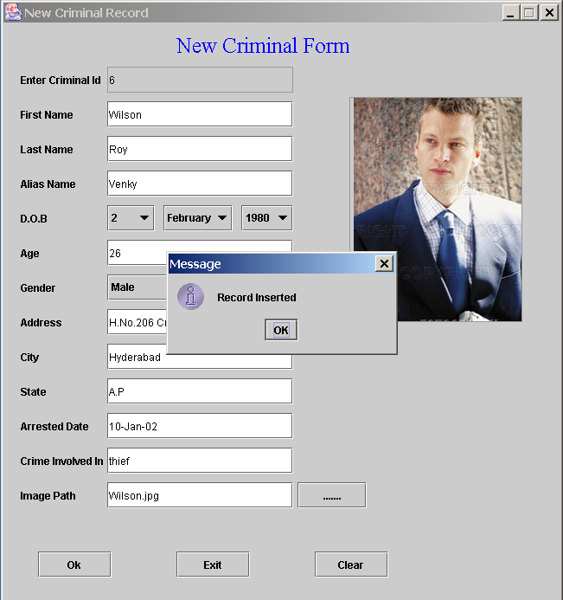
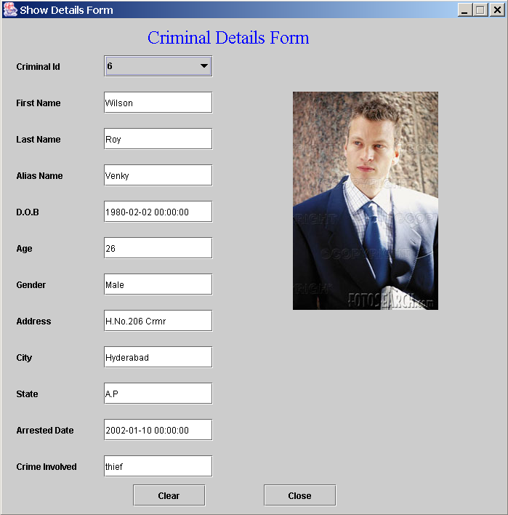
NEW CRIMINAL FORM
SHOW DETAILS

Slide 16
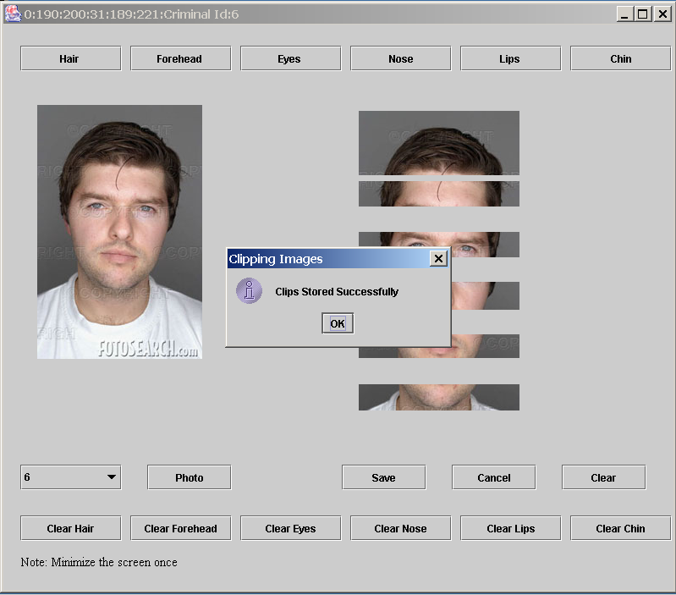
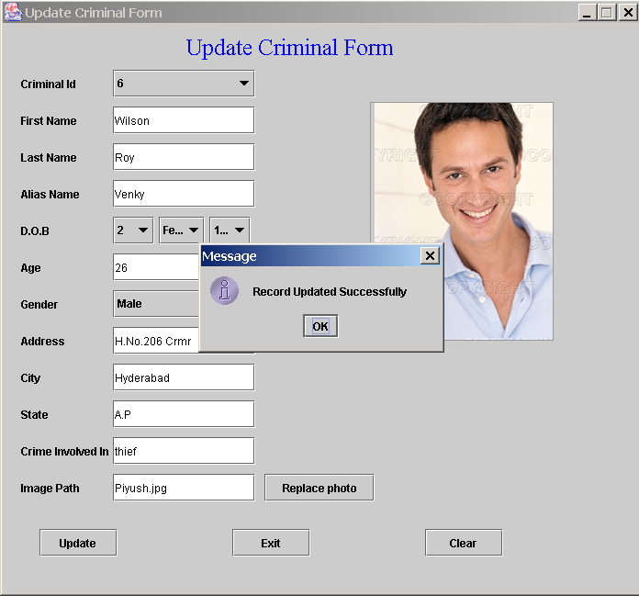
CLIP IMAGE SCREEN
UPDATE DETAILS SCREEN

Slide 17
Test Cases
S.no. | Screen | Input | Output | Remarks
1 | Login Page | User Id Password | User validation | User will enter into Main Screen
2 | Main Screen File New | Criminal Details are entered | Details are stored in the database | New Menu is selected to enter new criminal details.
3 | Main Screen File Show Details | Display option is clicked. | Criminal Details are displayed | Display details menu is selected to get details from database.
4 | Main Screen File Exit | Exit Option is Clicked. | Screen will be exited | Screen will be shut down
5 | Main Screen Edit Clip Image | Criminal Image is clipped into different parts | The clips are stored in database | Clip image menu is selected to clip image and store them in database

Slide 18
Conclusion
The purpose of face identification system is to identify criminals. In past years this process is carried out by humans. This process may give the image of the criminal but it is very difficult to identify the criminal details and also it requires much amount of human burden.
The main aim of our project is to overcome the drawbacks of human based system by using the machine based face identification process.

Slide 19
References
BOOKS REFERRED
The following books were used extensively for the project development and implementation.
1. “The Complete Reference Java2” Tata McGraw-Hill publishing Company Limited. By Herbert Schildt.
2. “Software Engineering, A Practitioner’s Approach” Tata McGraw-Hill Publishing Company Limited. By Roger S. Pressman.
3. “PL/SQL”. By Ivan Bayross.
WEBSITES REFERRED
The following links were searched and exploited extensively for the project development and implementation.
1. http://www.java.sun.com/products\java
2. http://www.jakarta.apache.org
3. http://www.javaworld.com/
4. http://www.java2s.com/

